Slide 1
版本控管(Version Control)概念以國票證券SVN版控為例
Speaker : Vincent

Slide 2
OUTLINE
相關軟體
SVN (Subversion) 觀念
Revision Graph
Commit, Update, Revert, Branch / Tag, Switch, Merge, Lock / UnLock, Conflict
SVN Command
Hook Script
實際操作與常見狀況處理
Create Branch / Tag
Switch Repository and Commit
Commit To The Wrong Repository
Merge and Solve Conflict
SVN 相關應用
CommitLog Program
SqlLog Program
SVN Create Tag with Jenkins
Keep SVN Synchronize with Jenkins

Slide 3
Related Software
SVN client – TortoiseSVN
SVN server - Visual SVN Server Manager
Eclipse plug-in – Subclipse or Subversive
 | TortoiseSVN | Subclipse | Subversive
缺點 | 無版本合併線 | 版本圖不直觀(單一檔案) | 合併概念不同
Notes:
解釋合併實作方法不同

Slide 4
When to Use It
TortoiseSVN
* 版本圖直觀，缺點是沒有合併線
* 通常用於兩邊同時對照或是沒有Eclipse的狀況
Subclipse
* 在Eclipse中使用
* 用於會發生衝突的合併，可標記多個衝突稍後解決
Subversive
* 檢視版本圖

Slide 5
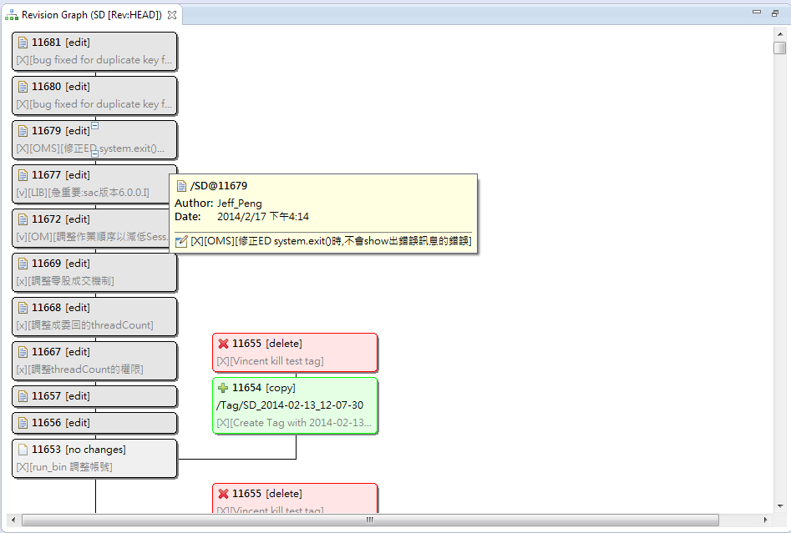
Revision Graph - project(gt\SD)
Notes:
版本資訊
自由進退

Slide 6
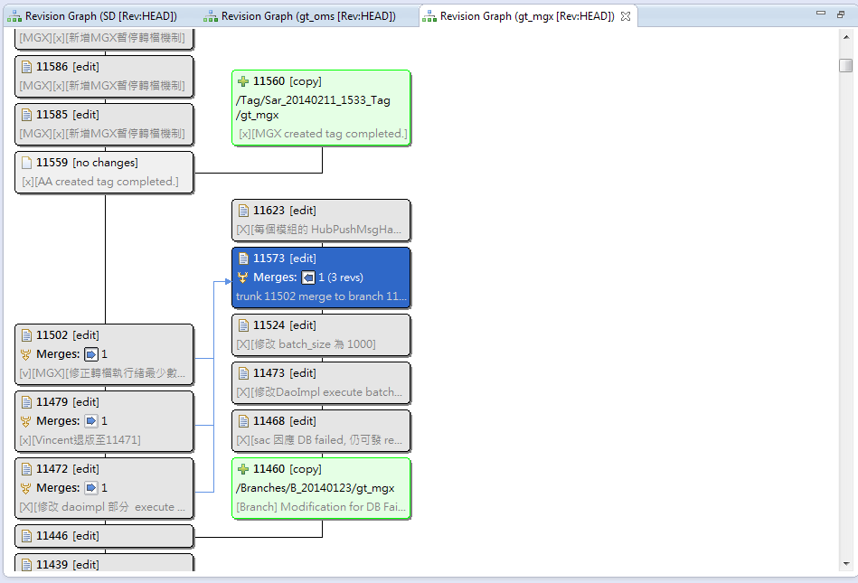
Revision Graph – module(gt\SD\oms)
Notes:
版本資訊
自由進退

Slide 7
Common Operation
Commit (別忘記Commit Log唷)
Update (更新至特定版本, 解決衝突)
Revert
Branch / Tag
Switch
Merge (解決衝突)
Lock / UnLock
Conflict

Slide 8
Branch / Tag
svn copy https://172.16.220.169:8443/svn/gt/SD https://172.16.220.169:8443/svn/gt/Tag/SD_%BUILD_ID% -m "[X][Create Tag with %BUILD_ID%]“
本質上就是複製檔案庫, 兩者概念相同, 用途不同
 | Branch | Tag
用途 | 避免影響Trunk前提下 將程式碼提交在Branch進行新功能開發或測試 根據需求又有 合併 / 不合併 的的狀況 | 特定版本的標記

Slide 9
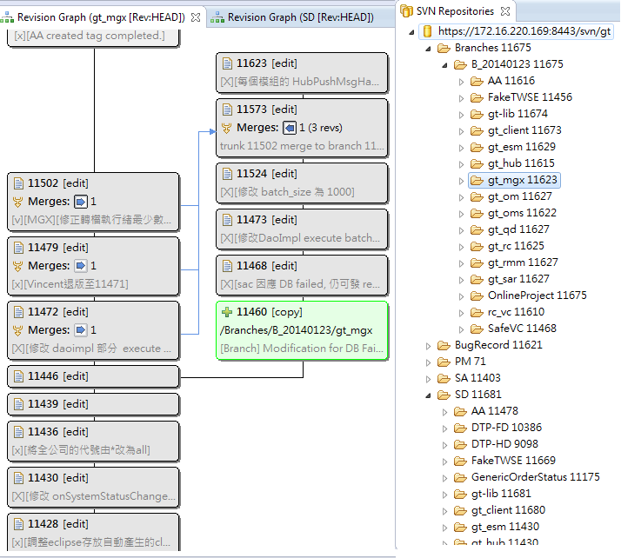

Slide 10
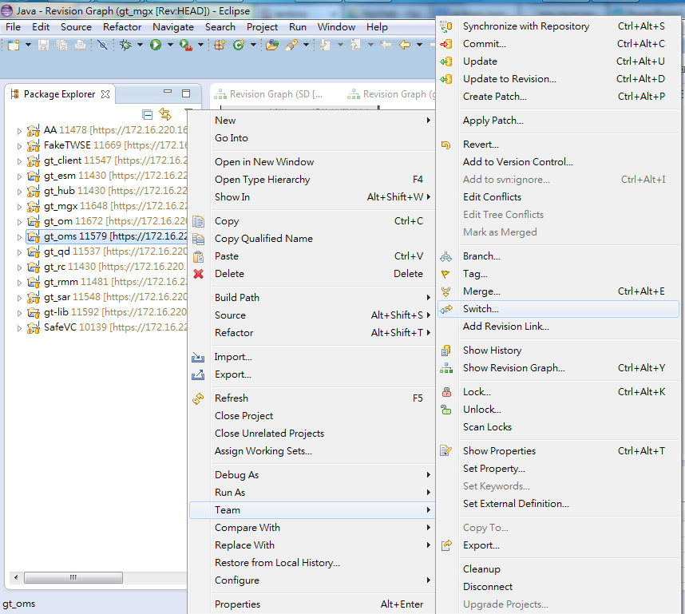
Switch (1/3)
切換專案對應的檔案庫 (Trunk switch to Branch)

Slide 11
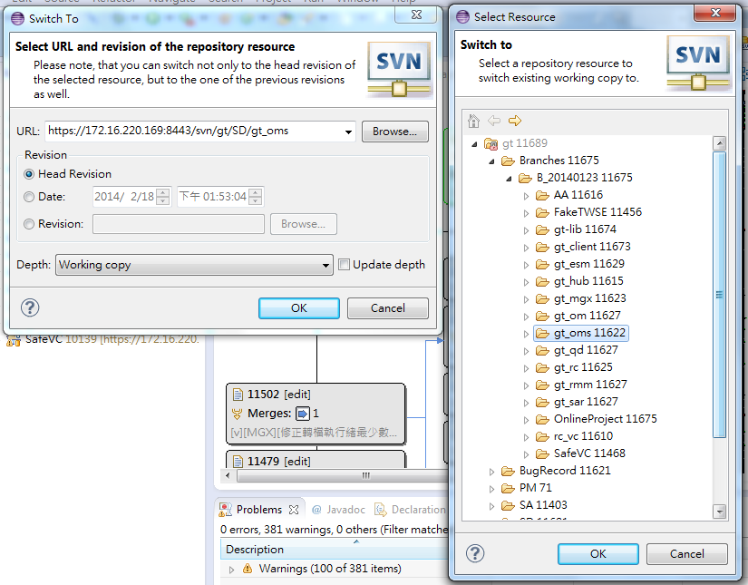
Switch (2/3)
切換專案對應的檔案庫 (Trunk switch to Branch)

Slide 12
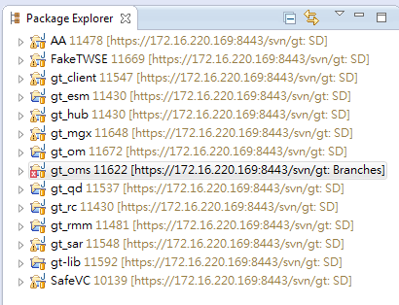
Switch (3/3)
切換專案對應的檔案庫 (Trunk switch to Branch)

Slide 13
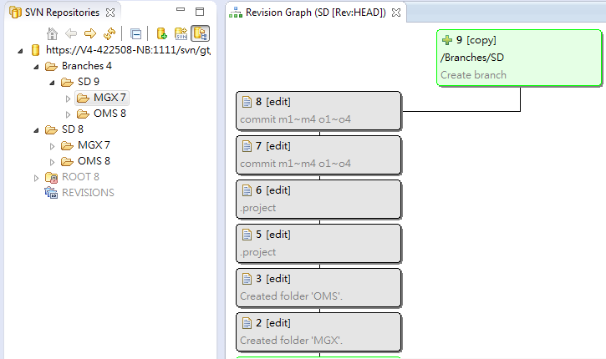
Merge (1/5)
檔案庫合併(無衝突) Branch merge to Trunk

Slide 14
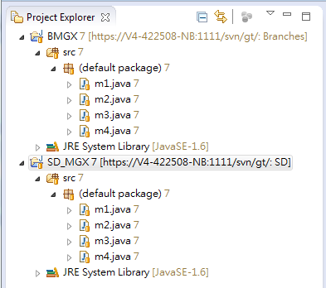
Merge (2/5)
檔案庫合併(無衝突) Branch merge to Trunk

Slide 15
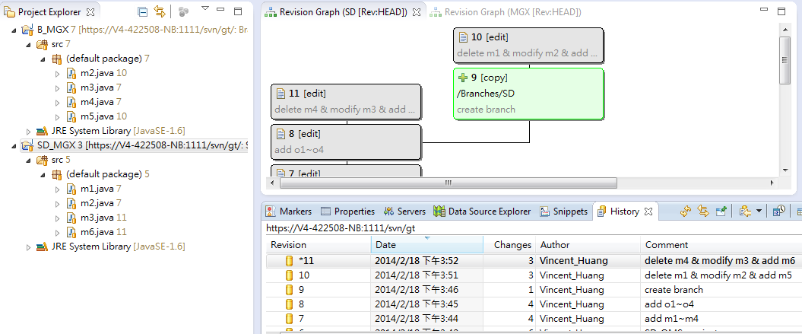
Merge (3/5)
檔案庫合併(無衝突) Branch merge to Trunk

Slide 16
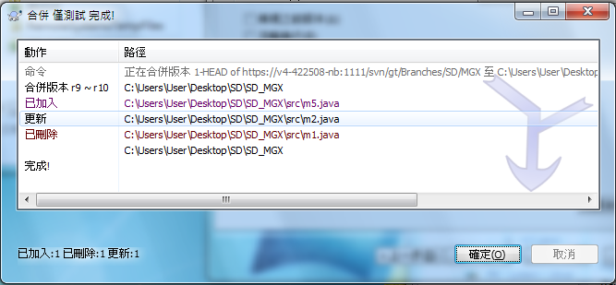
Merge (4/5)
檔案庫合併(無衝突) Branch merge to Trunk

Slide 17
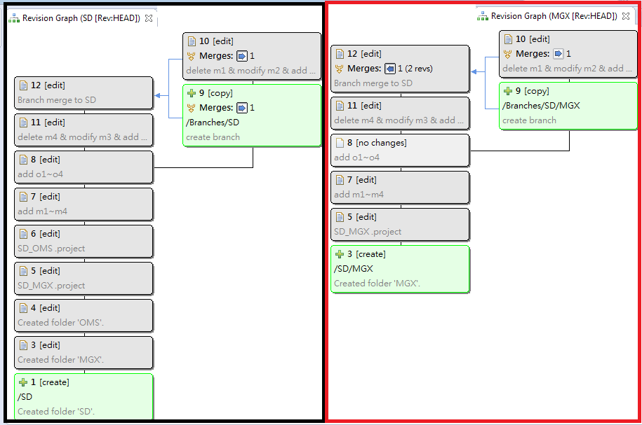
Merge (5/5)
檔案庫合併(無衝突) Branch merge to Trunk

Slide 18
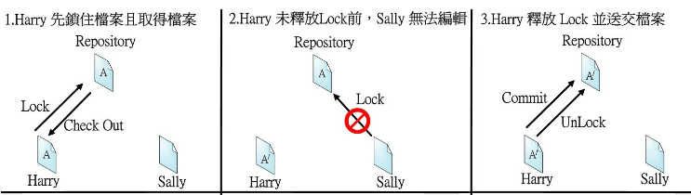
Lock / Unlock
* Steal Lock : 拿到鎖定者的權限
* Break Lock : 斷開鎖鏈

Slide 19
Conflict
File conflict A file conflict occurs if two (or more) developers have changed the same few lines of a file.
Property conflict A property conflict occurs when two or more developers have changed the same property.
Tree conflict A tree conflict occurs when a developer moved/renamed/deleted a file or folder, which another developer either also has moved/renamed/deleted.

Slide 20
Common SVN Command
svn (Subversion Command Line Client)
對檔案的操作 ex. checkout, add, delete, copy , …
svnadmin (Subversion Repository Administration)
對檔案庫的操作 ex. create, dump, hotcopy, load, …
svnlook (Subversion Repository Examinamtion)
讀取每次commit的相關訊息 ex. author, date, log , changed, …

Slide 21
Hook Script
start-commit
(Access control)
pre-commit
(Validation and Control)
post-commit
(Commit notification;
Tool Integration)
pre-revprop-commit
(Access control;
Validation and Control)
post-revprop-commit
(Property Change Notification)
pre-lock
(Access control)
post-lock
(Lock Notification)
pre-unlock
(Access control)
post-unlock
(UnLock Notification)

Slide 22
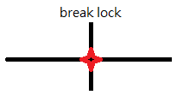
Trigger Timing
start-commit
pre-commit
post-commit
pre-revpop-change
post-revpop-change
pre-lock
post-lock
pre-unlock
post-unlock
Notes:
start-commit
檢視檔案庫資訊(repos, author, …)，決定exit 0 or 1
pre-commit
檢視svnlook條件決定exit 0 or 1
post-commit
已成功提交，無法rollback，常用於介接其他工具(DB, Email, Dump)
pre-revprop-change (預設回傳非零值)
檢視條件決定exit 0 or 1
post-revprop-change
已成功更改，無法rollback ，常用於介接其他工具(DB, Email)
pre-lock
檢視條件決定誰可以鎖定 (建立lock或是偷lock) exit 0 or 1
post-lock
已成功上鎖，無法rollback，常用於介接其他工具(DB, Email)
pre-unlock
檢視條件決定誰可以解鎖 (解除lock或是斷開鎖鏈) exit 0 or 1
Post-unlock
已成功解鎖，無法rollback，常用於介接其他工具(DB, Email)

Slide 23
Branch / Tag with Software
分支與合併之軟體比較
 | tortoiseSVN |  | subclipse |  | subversive
 | 分支 | 合併 | 分支 | 合併 | 分支 | 合併
專案 | O | O(吃別人) | O | O(吃別人) | O | O(吃別人)
歷史紀錄 | O | O(併進去) | O | X | O | X
檔案庫 | X | X | O | X | O | X
版本圖 | X | O(併進去) |  |  | O | X

Slide 24
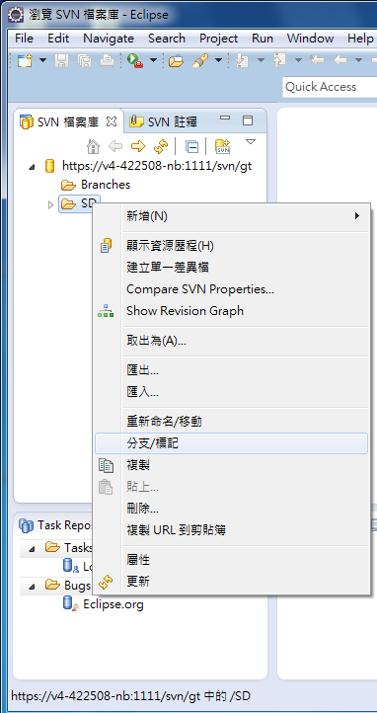
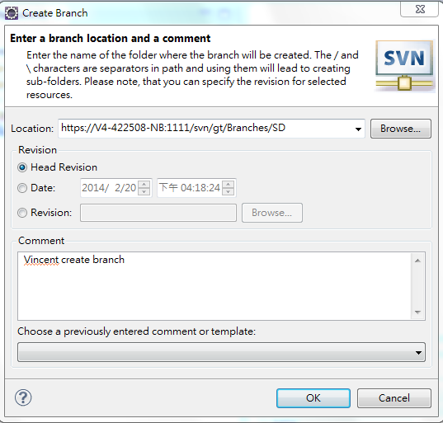
Use Subclipse to Create Branch / Tag (1/2)

Slide 25
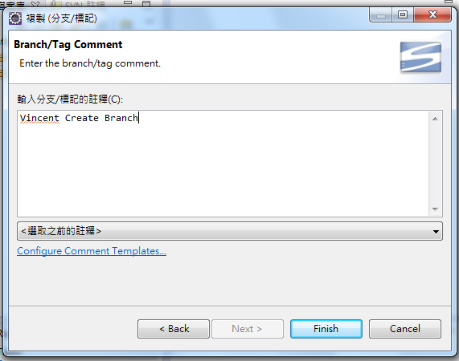
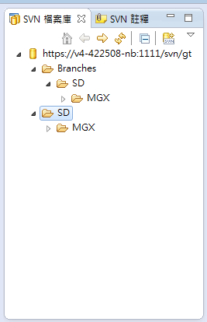
Use Subclipse to Create Branch / Tag (2/2)

Slide 26
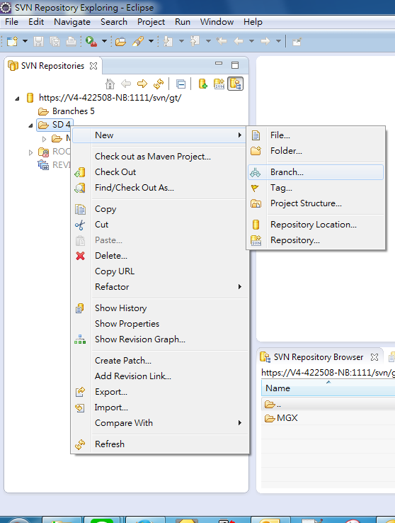
Use Subversive to Create Branch / Tag (1/2)

Slide 27
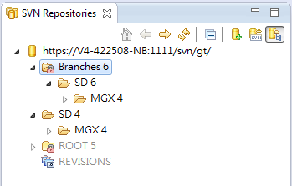
Use Subversive to Create Branch / Tag (2/2)

Slide 28
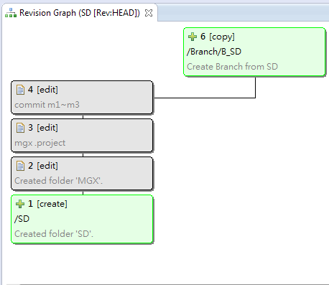
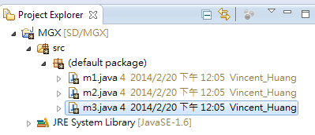
Switch Repository and Commit (1/4)
發生狀況 專案產生切Branch的需求(測試、功能開發、…)，而本機已存在修改過的Code
處理步驟 1 Create Branch 2 Switch to Branch 3 Commit Code To Branch
* 若switch過去的檔案庫結構樹不同，將發生衝突禁止switch
* 若沒有存在修改過的code則不會發生衝突

Slide 29
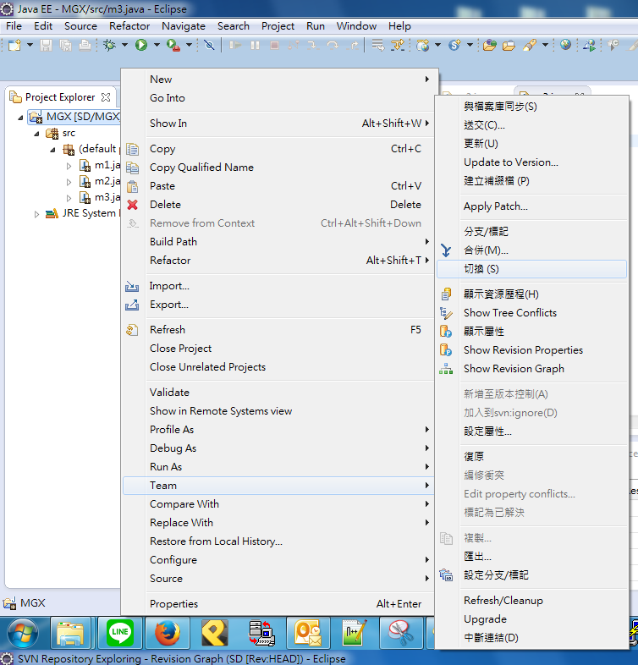
Switch Repository and Commit (2/4)
發生狀況 專案產生切Branch的需求(測試、功能開發、…)，而本機已存在修改過的Code
處理步驟 1 Create Branch 2 Switch to Branch 3 Commit Code To Branch
* 若switch過去的檔案庫結構樹不同，將發生衝突禁止switch
* 若沒有存在修改過的code則不會發生衝突

Slide 30
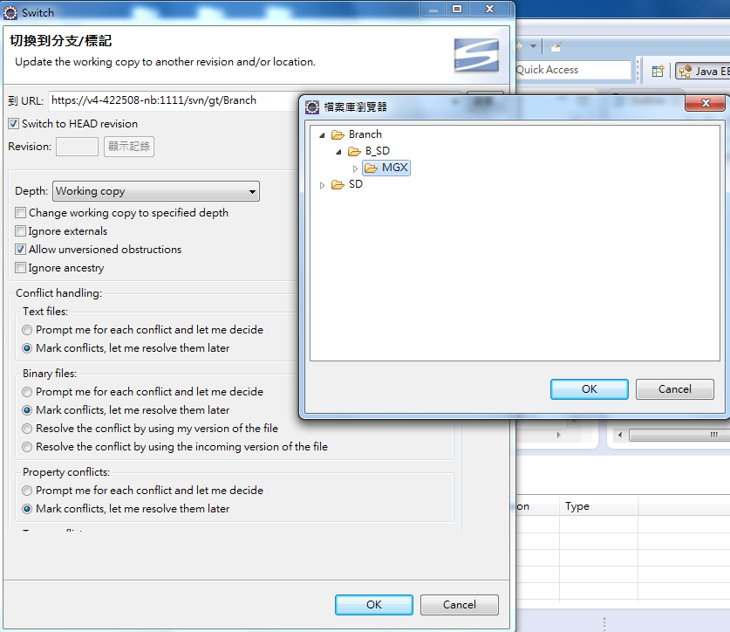
Switch Repository and Commit (3/4)
發生狀況 專案產生切Branch的需求(測試、功能開發、…)，而本機已存在修改過的Code
處理步驟 1 Create Branch 2 Switch to Branch 3 Commit Code To Branch
* 若switch過去的檔案庫結構樹不同，將發生衝突禁止switch
* 若沒有存在修改過的code則不會發生衝突

Slide 31
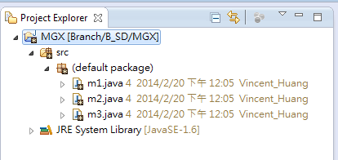
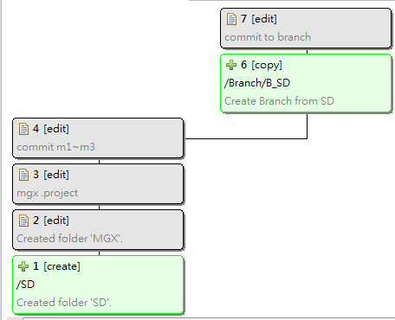
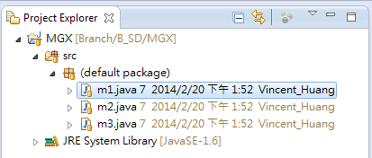
Switch Repository and Commit (4/4)
發生狀況 專案產生切Branch的需求(測試、功能開發、…)，而本機已存在修改過的Code
處理步驟 1 Create Branch 2 Switch to Branch 3 Commit Code To Branch
* 若switch過去的檔案庫結構樹不同，將發生衝突禁止switch
* 若沒有存在修改過的code則不會發生衝突

Slide 32
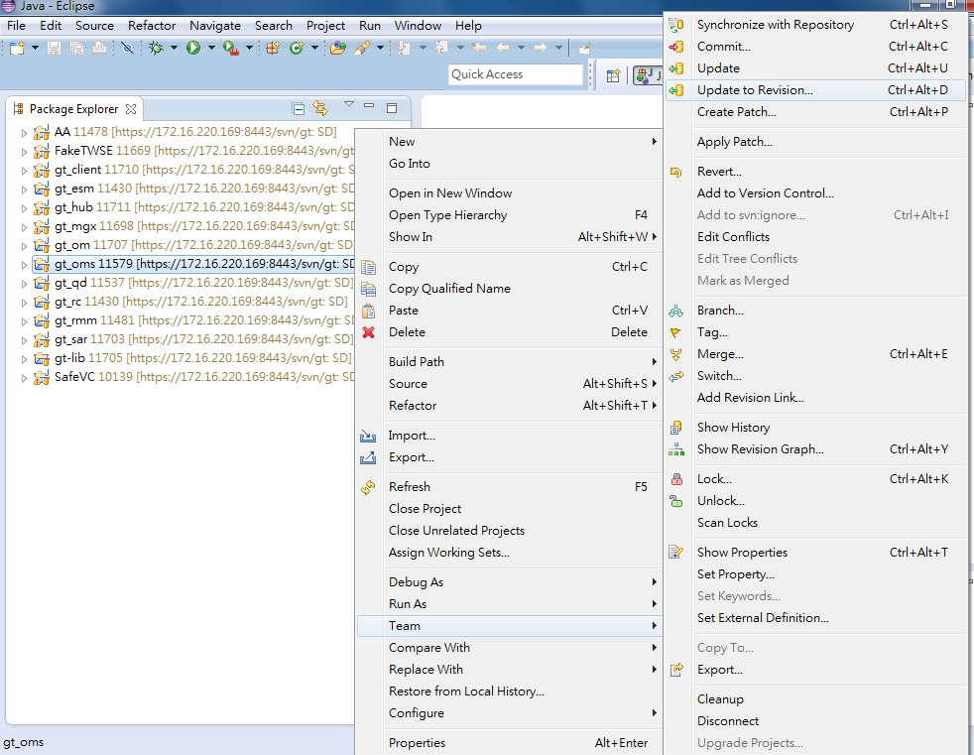
Commit To The Wrong Repository (1/5)
發生狀況： 11433切Branch, 已修改的Code要上錯地方上到Trunk
解決方法： 1 更新至特定版號 2 執行Override & Commit
適用情況： 錯誤的Commit (錯誤位置、暫停Commit)
* 及早發現，及早治療 * 大絕招，開Branch壓回去

Slide 33
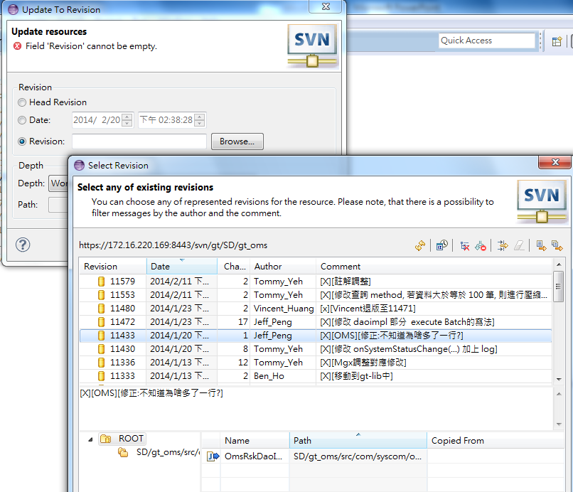
Commit To The Wrong Repository (2/5)
發生狀況： 11433切Branch, 已修改的Code要上錯地方上到Trunk
解決方法： 1 更新至特定版號 2 執行Override & Commit
適用情況： 錯誤的Commit (錯誤位置、暫停Commit)
* 及早發現，及早治療 * 大絕招，開Branch壓回去

Slide 34
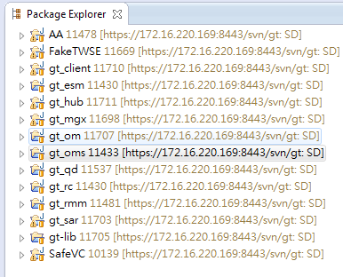
Commit To The Wrong Repository (3/5)
發生狀況： 11433切Branch, 已修改的Code要上錯地方上到Trunk
解決方法： 1 更新至特定版號 2 執行Override & Commit
適用情況： 錯誤的Commit (錯誤位置、暫停Commit)
* 及早發現，及早治療 * 大絕招，開Branch壓回去

Slide 35
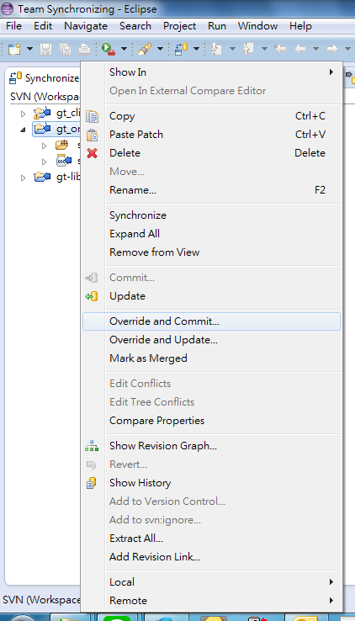
Commit To The Wrong Repository (4/5)
發生狀況： 11433切Branch, 已修改的Code要上錯地方上到Trunk
解決方法： 1 更新至特定版號 2 執行Override & Commit
適用情況： 錯誤的Commit (錯誤位置、暫停Commit)
* 及早發現，及早治療 * 大絕招，開Branch壓回去

Slide 36
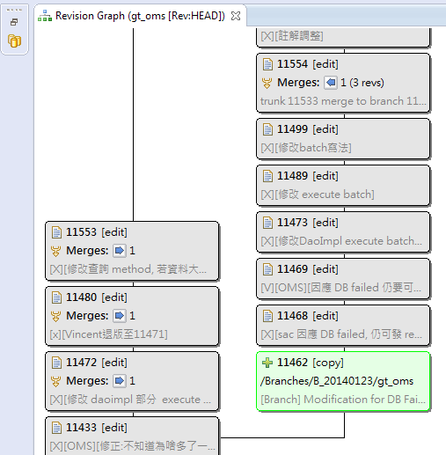
Commit To The Wrong Repository (5/5)
發生狀況： 11433切Branch, 已修改的Code要上錯地方上到Trunk
解決方法： 1 更新至特定版號 2 執行Override & Commit
適用情況： 錯誤的Commit (錯誤位置、暫停Commit)
* 及早發現，及早治療 * 大絕招，開Branch壓回去
Notes:
大絕招，切Branch壓回去

Slide 37
Merge and Solve Conflict
merge概念與update類似
不動到相同的檔案為前提下 (no conflict)
Ex. Branch and Trunk all have m1~m4.java
＊注意delete & update的動作 (會直接地影響被合併者)
Branch | merge to Trunk | Result
add m5.java | >>>>>> | add m5.java
delete m1.java | >>>>>> | delete m1.java
update m2.java | >>>>>> | update m2.java

Slide 38
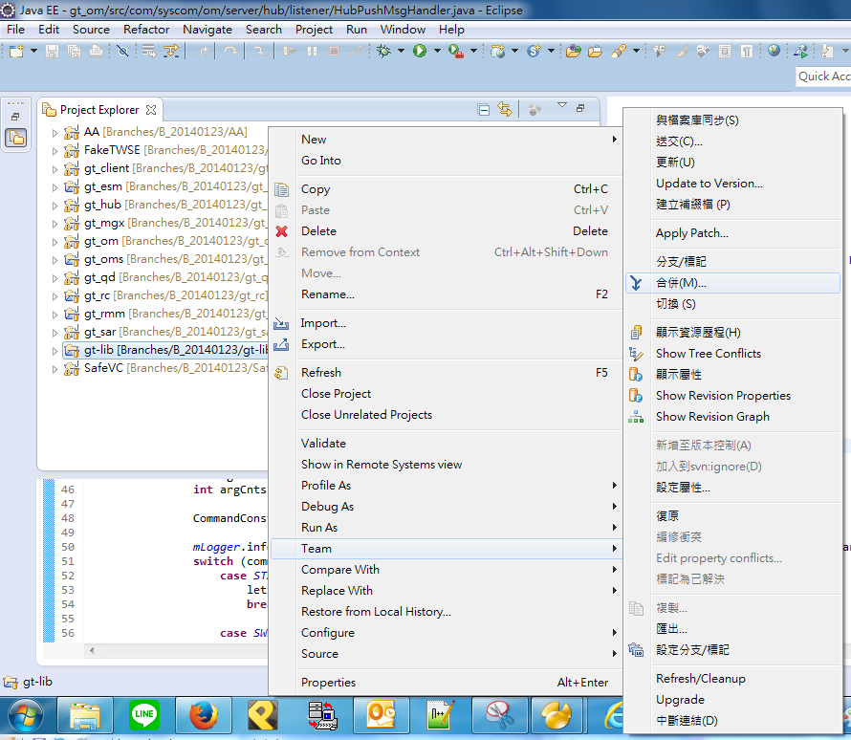
Merge and Solve Conflict (1/10)
檔案庫合併(有衝突) 以gt為例 Trunk merge to Branch

Slide 39
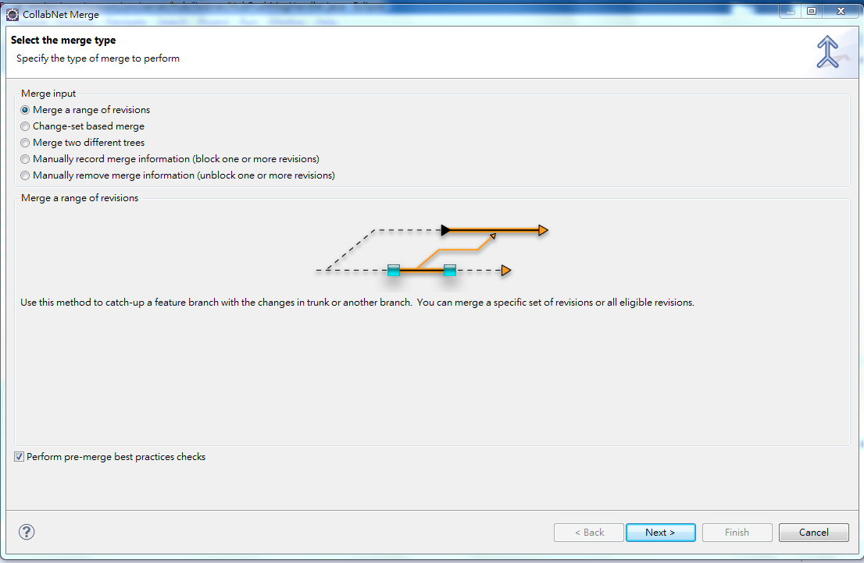
Merge and Solve Conflict (2/10)
檔案庫合併(有衝突) 以gt為例 Trunk merge to Branch

Slide 40
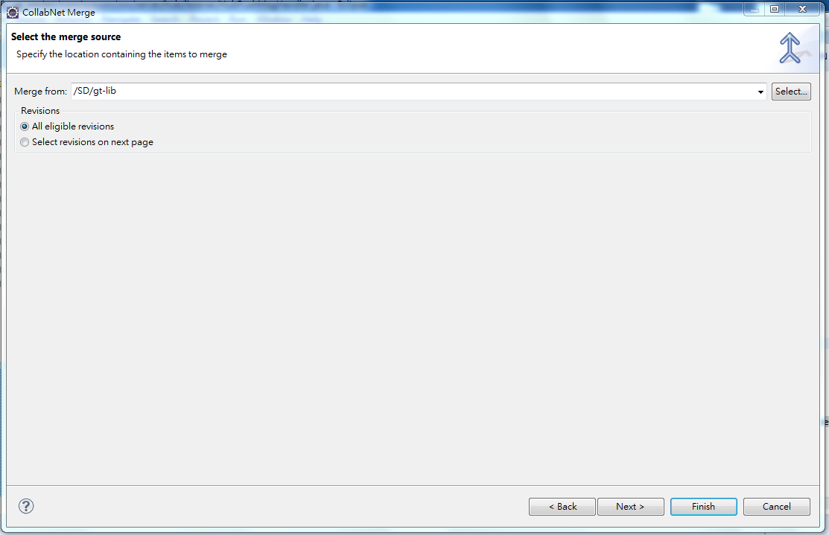
Merge and Solve Conflict (3/10)
檔案庫合併(有衝突) 以gt為例 Trunk merge to Branch

Slide 41
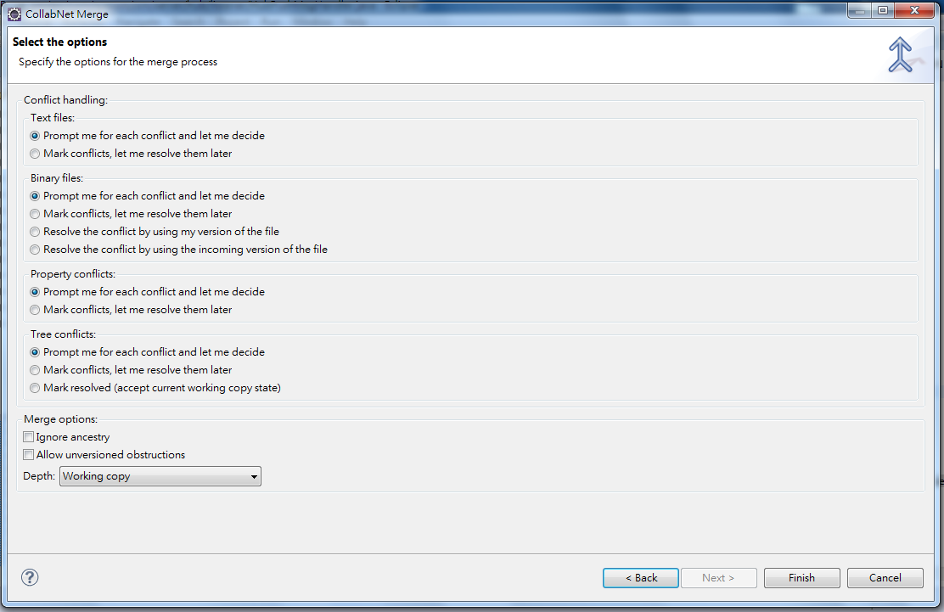
Merge and Solve Conflict (4/10)
檔案庫合併(有衝突) 以gt為例 Trunk merge to Branch

Slide 42
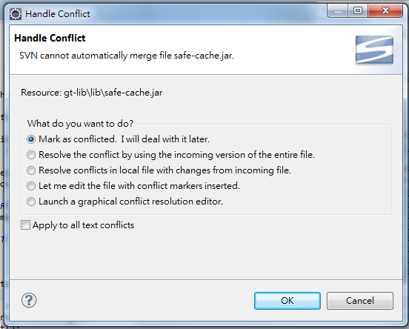
Merge and Solve Conflict (5/10)
檔案庫合併(有衝突) 以gt為例 Trunk merge to Branch

Slide 43
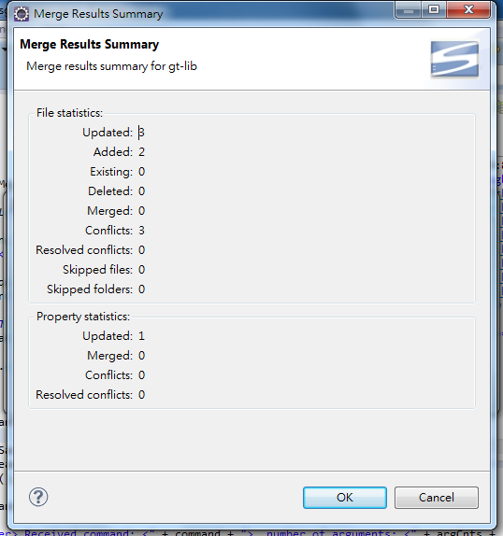
Merge and Solve Conflict (6/10)
檔案庫合併(有衝突) 以gt為例 Trunk merge to Branch

Slide 44
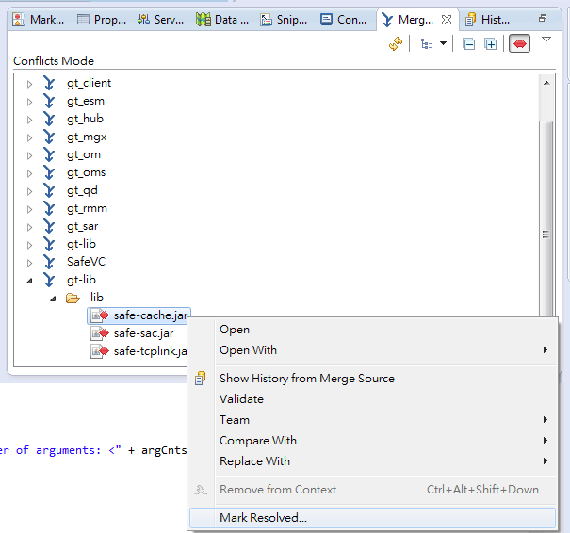
Merge and Solve Conflict (7/10)
檔案庫合併(有衝突) 以gt為例 Trunk merge to Branch

Slide 45
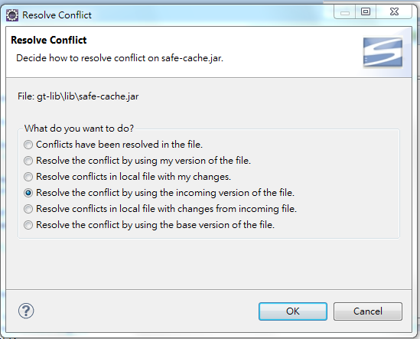
Merge and Solve Conflict (8/10)
檔案庫合併(有衝突) 以gt為例 Trunk merge to Branch

Slide 46
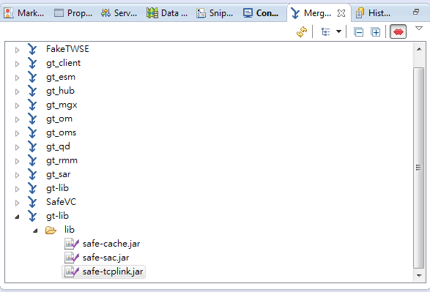
Merge and Solve Conflict (9/10)
檔案庫合併(有衝突) 以gt為例 Trunk merge to Branch

Slide 47
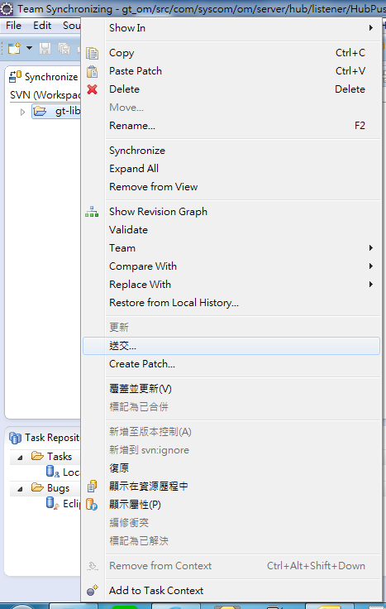
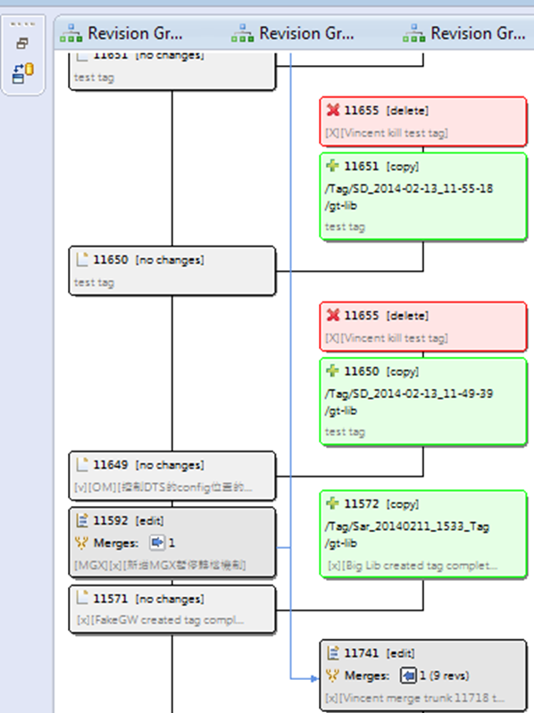
Merge and Solve Conflict (10/10)
檔案庫合併(有衝突) 以gt為例 Trunk merge to Branch

Slide 48
CommitLog Program
使用pre-commit hook 在commit時用svnlook取得資訊 (author, date, log, changed, youngest, …)
將這些資訊作為參數傳入java program
pre-commit.bat
PreCommitVerify.java
Exit 1 ParseTxtToDB.java ExceptionNotify.java
with errorlevel > 0
error
success
send mail if catch exception

Slide 49
CommitLog Program
使用pre-revprop-change hook 允許修改log, 禁止修改author
使用post-revprop-change hook update DB with 修改的log
pre-revprop-change.bat post-revprop-change.bat
Exit 0 Exit 1 UpdateLogToDB.java
ExceptionNotify.java
success
error
send mail if catch exception

Slide 50
CommitLog Format
[v][module_name][Spec_Name / Bug_Id][log]
[x][log]
Ex : [V][OMS][GT-DSKOM100-ODR-UI-002][當DB failed時, 委託異動以及勾單UI 按下refresh按鈕時,前端cache的資料不會被清空] [V][OMS][Bug123][刪除全公司 & 投資人選項] [x][將全公司的代號由*改為all]

Slide 51
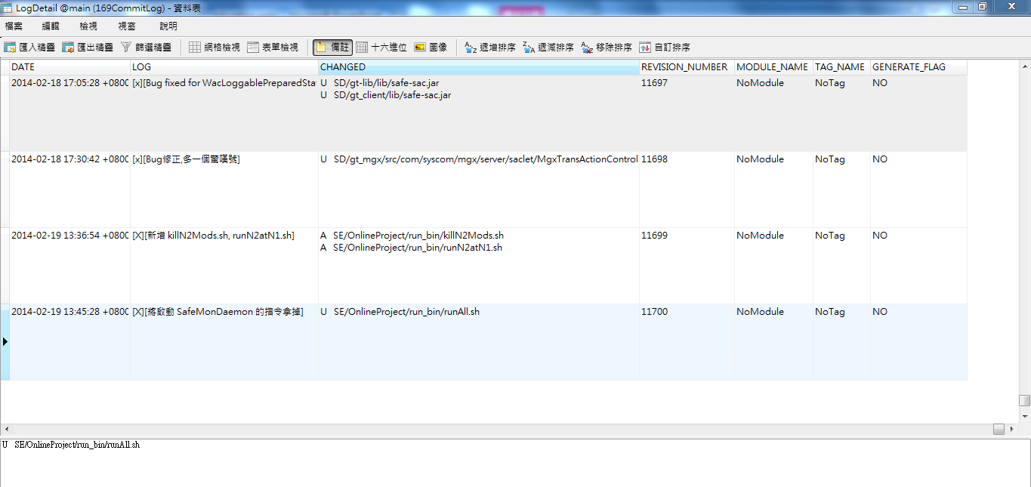
CommitLog DB

Slide 52
CommitLog with Build
與Ant介接，Build版時 將DB內容輸出Excel作為附件 再以java mail寄出
讓Ant在Build版時呼叫 OutputExcel.java BuildVersionNotify.java 實現自動產生異動清單並寄Build版通知信

Slide 53
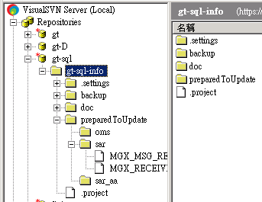
SqlLog Program
backup : Build版前備份
doc : DB文件
*preparedToUpdate : 放預備更新的sql檔案
Notes:
動到preparedToUpdate才會寄信

Slide 54
SqlLog Program
使用pre-commit hook 在commit時用svnlook取得資訊 (author, date, log, changed, youngest, …)
將這些資訊作為參數傳入java program
pre-commit.bat
SqlLogVerify.java
Exit 1 RecordAndNotify.java
SqlSendMailNotify.java ExceptionNotify.java
with errorlevel > 0
error
success
send mail with commit info
send mail if catch exception

Slide 55
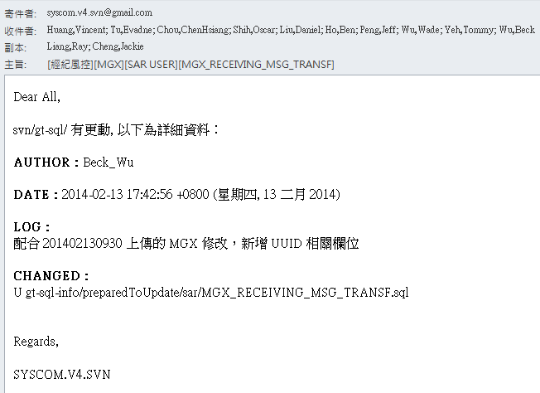
SqlLog Format
[Project_Name][Module_Name][DB_USER][TABLE_Name1 / …] log
Ex : [經紀風控][MGX][SAR USER][MGX_RECEIVING_MSG_TRANSF] 配合201402130930上傳的MGX修改，新增UUID相關欄位

Slide 56
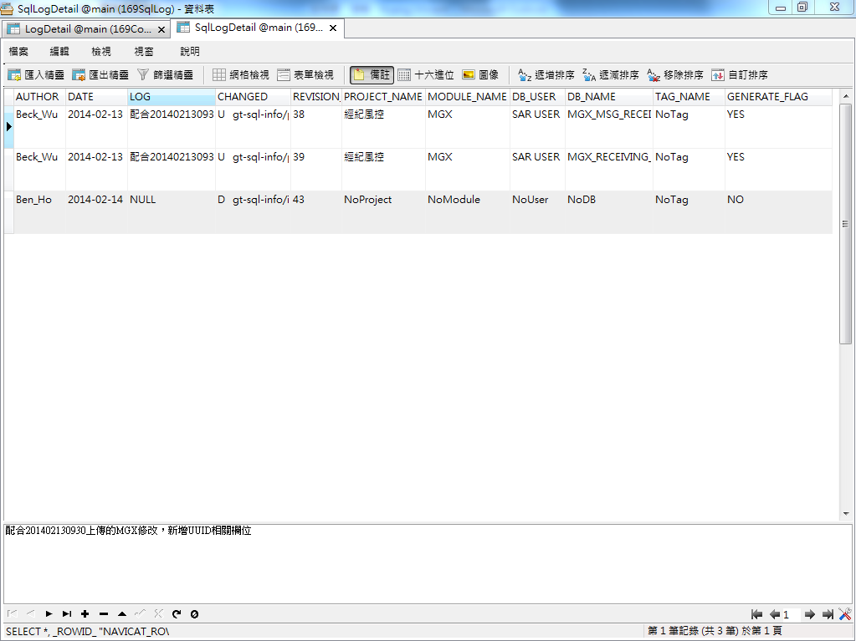
SqlLog DB

Slide 57
SqlLog with Build
與Ant介接 在Build版前備份，放入gt-sql-info\backup 再執行gt-sql-info\preparedToUpdate\*.sql
讓Ant在Build版時呼叫DB相關的Target

Slide 58
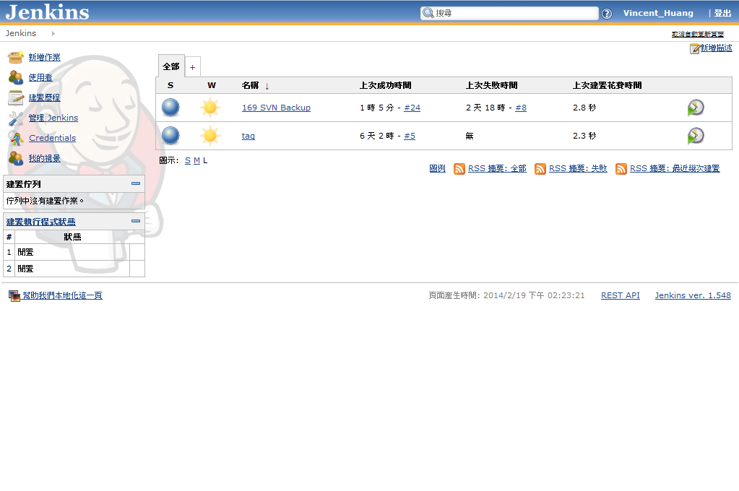
SVN Create Tag with Jenkins (1/2)

Slide 59
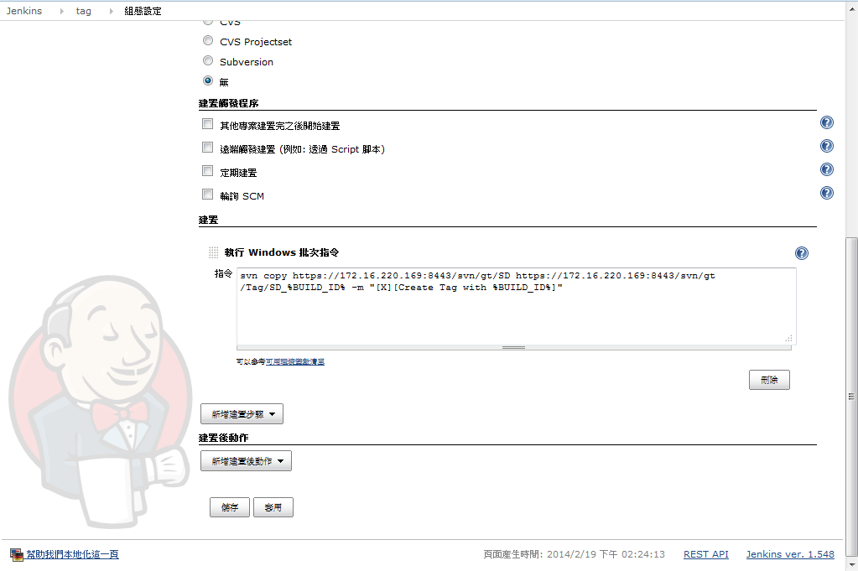
SVN Create Tag with Jenkins (2/2)

Slide 60
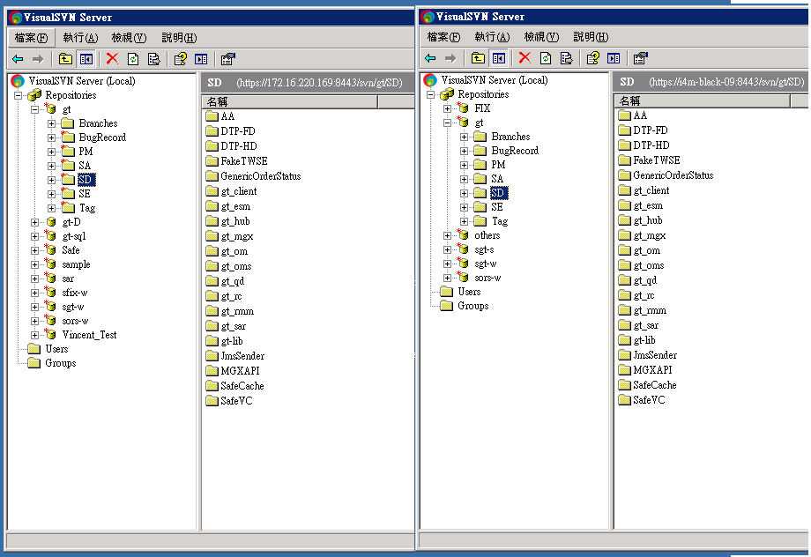
Keep SVN Synchronize with Jenkins (1/4)

Slide 61
Keep SVN Synchronize with Jenkins (2/4)
在175上的Jenkins建立一個專案 此專案執行時將呼叫以下三支Ant Program getYoungest.xml youngest.properties last_dump.properties dumpItOrNot.xml isChanged.properties dumpItAndLoad.xml
write property
load property
check ${youngest } equals ${last_dump} or not
not equal, dump the revision and set property isChanged to true
is equal, set property isChanged to false
load property
check ${isChanged } equals true or not
true
false
load dump file to another svn repository
Bye Bye!

Slide 62
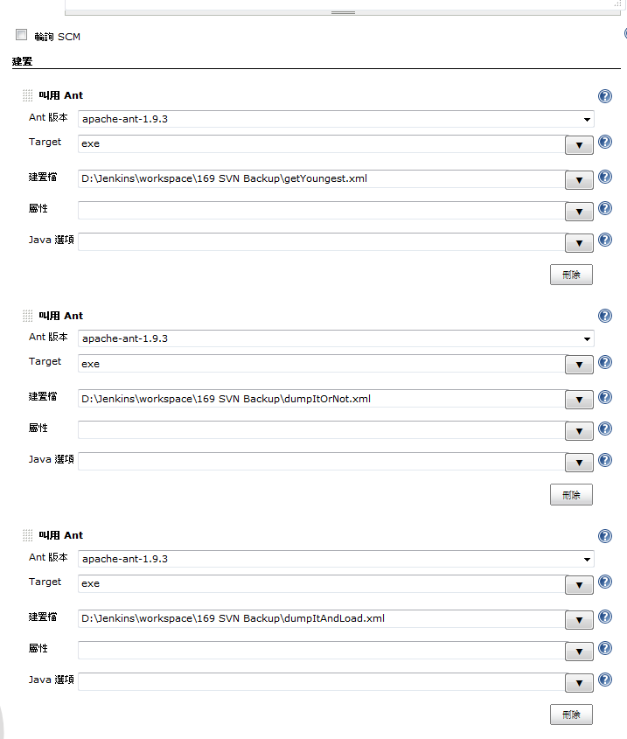
Keep SVN Synchronize with Jenkins (3/4)

Slide 63

Keep SVN Synchronize with Jenkins (4/4)

Slide 64
Reference
tortoiseSVN http://tortoisesvn.tigris.org/
VisualSVN Server Manager http://www.visualsvn.com/
Subclipse http://subclipse.tigris.org/
Subversive https://www.eclipse.org/subversive/
SVNBook http://svnbook.red-bean.com/en/1.7/index.html
SVN 衝突(conflict)的介紹與解決 http://www.cc.ntut.edu.tw/~wkchen/game/SVN documents/SVNConflictOverview.pdf
NaviCat http://www.navicat.com/cht/
Jenkins http://jenkins-ci.org/

Slide 65
Q & A

